Slide 1
Session 2: Statistical Prerequisites to Machine Learning
Muriah Wheelock
Zack Markow
Please download the MATLAB code on box
‘Stats2Examples.m’
Notes:
This presentation and the listed hypothesis tests are not meant to be encyclopedic

Slide 2
outline
MW
Expanding on concepts from session 1
Hypothesis Testing Theory
Interpreting Hypothesis tests
Type I and Type II errors and Statistical Power

Slide 3
1. Expanding on concepts from session 1
MW
Fitting models to data
Error
Outliers
Population vs sample statistics

Slide 4
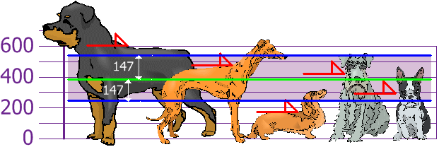
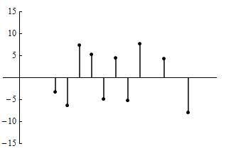
1a. Fitting Models to Data
MW
Last time we talked a lot about different data models which can be estimated using functions f(x)
Gaussian (normal) distribution
Gamma variate function (used to model BOLD and DOT responses to stimuli)
Cumulative distribution function
However, fitting functions to real (measured) data results in error
Error variance (e.g. standard deviation, standard error of the mean)

Slide 5
1a. Modeling brain and behavior
MW
Example 1:
We want to determine whether brain activity in prefrontal cortex functional connectivity predicts covid19-related anxiety symptoms
Independent variable: PFC functional connectivity
Dependent variable: trait anxiety symptoms
Many ways to model the data (linear, quadratic, etc.)
But it’s never a perfect fit with measured responses
There is error (variance) – also known as residuals
More on this next session
There are things that we haven’t modeled
If we haven’t modeled it, it contributes to the error
PFC
PFC functional connectivity
Trait anxiety

Slide 6
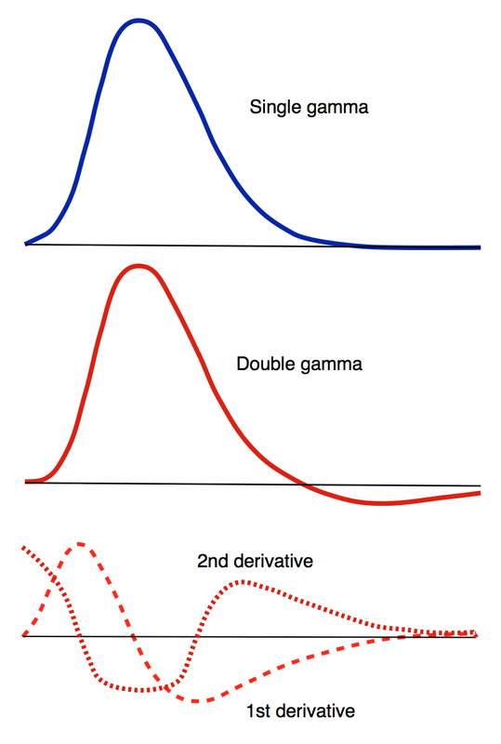
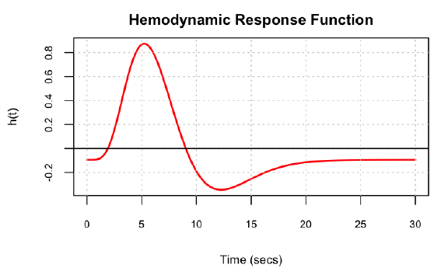
1a. Modeling hemodynamics
MW
Example 2:
Canonical HRF – predefined by investigator during analysis
Simple gamma variate response
1st and 2nd derivatives
Double gamma (undershoot)
Fourier basis sets
Model free
finite impulse response (FIR) function
major hit to degrees of freedom

Slide 7
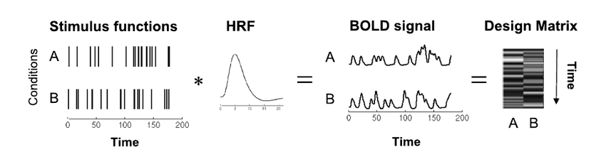
1a. Modeling hemodynamics
MW
Example 2:
Canonical HRF – predefined by investigator during analysis
Simple gamma variate response
1st and 2nd derivatives
Double gamma (undershoot)
Fourier basis sets

Slide 8
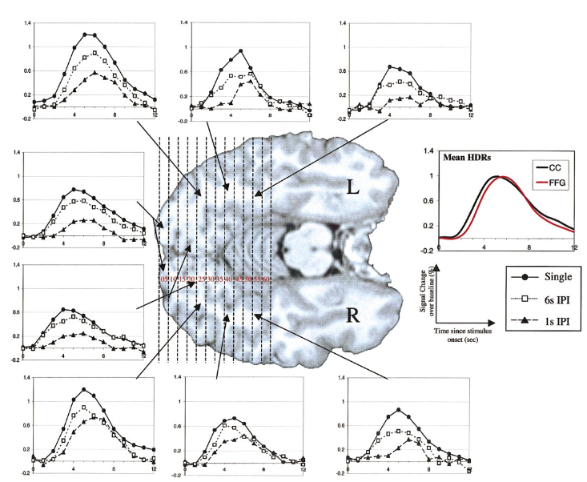
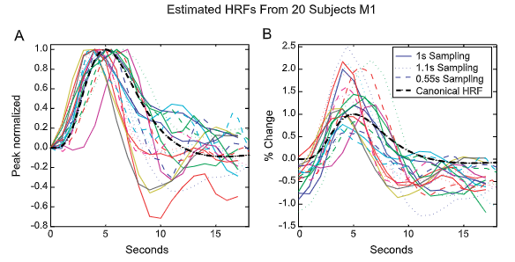
1a. Modeling hemodynamics
MW
Example 2:
Models don’t fit all subjects or all brain regions
Regional differences in group average hemodynamic response
Handwerker, Ollnger, D’Esposito (2004) NeuroImage
Huttel and McCarthy (2001) NeuroImage

Slide 9
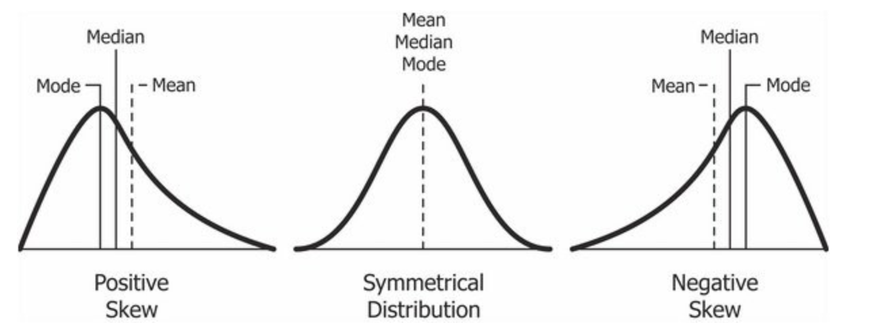
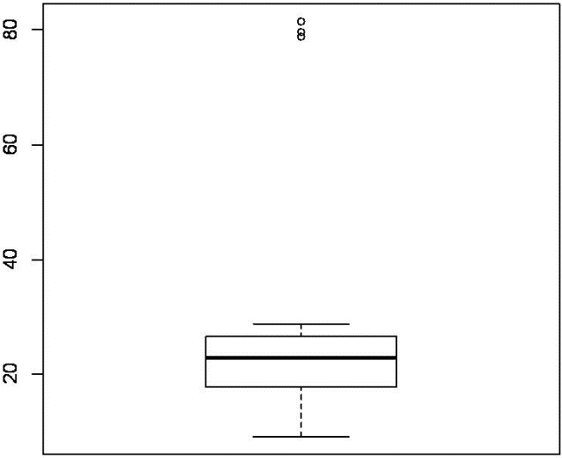
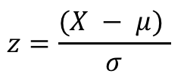
1a. Outliers and skew
MW
Univariate (and multivariate) outliers impact
sample standard deviation
sample mean
May reduce statistical power if normality is assumed
Matlab example: using z-scores to determine univariate outliers that are >3 SD from the mean
How should we best address outliers
Transform? Truncate? Exclude?
$$z=\frac{(X − μ) }{σ}$$

Slide 10
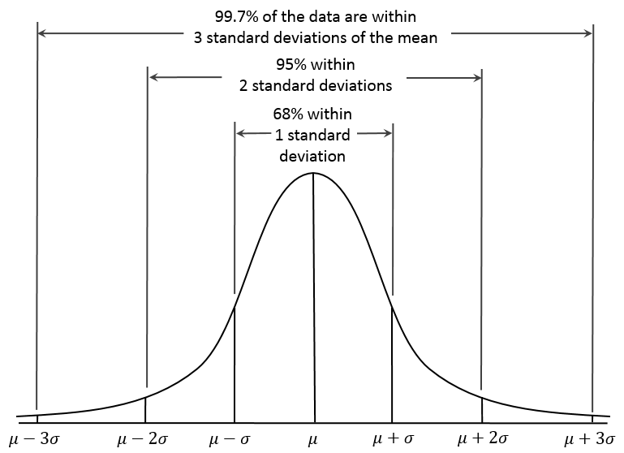
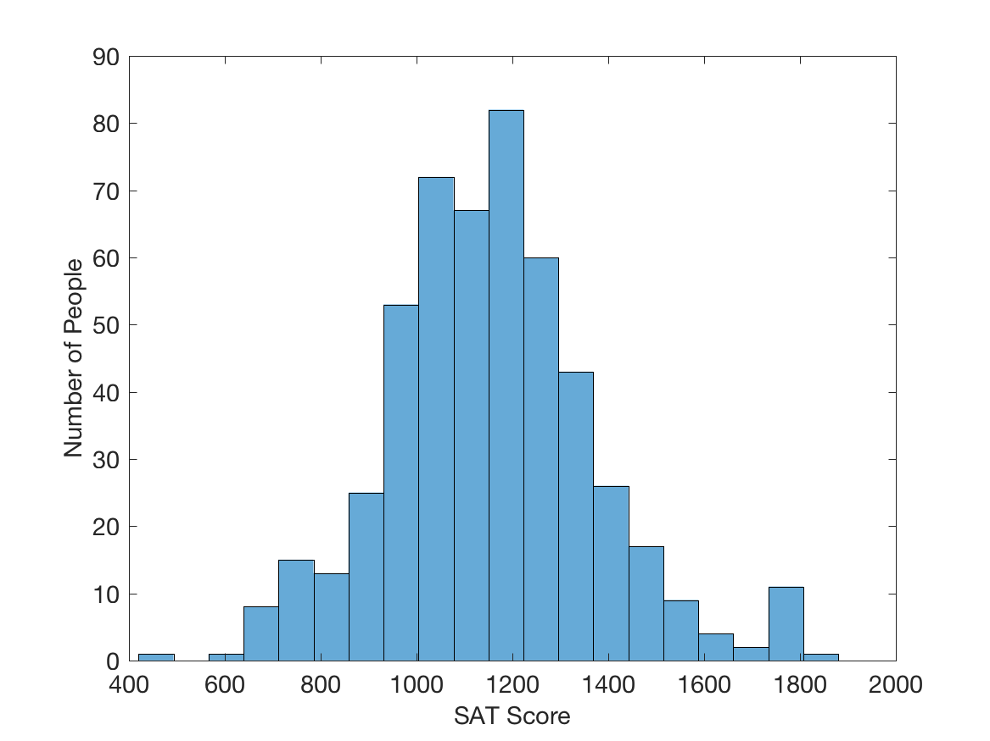
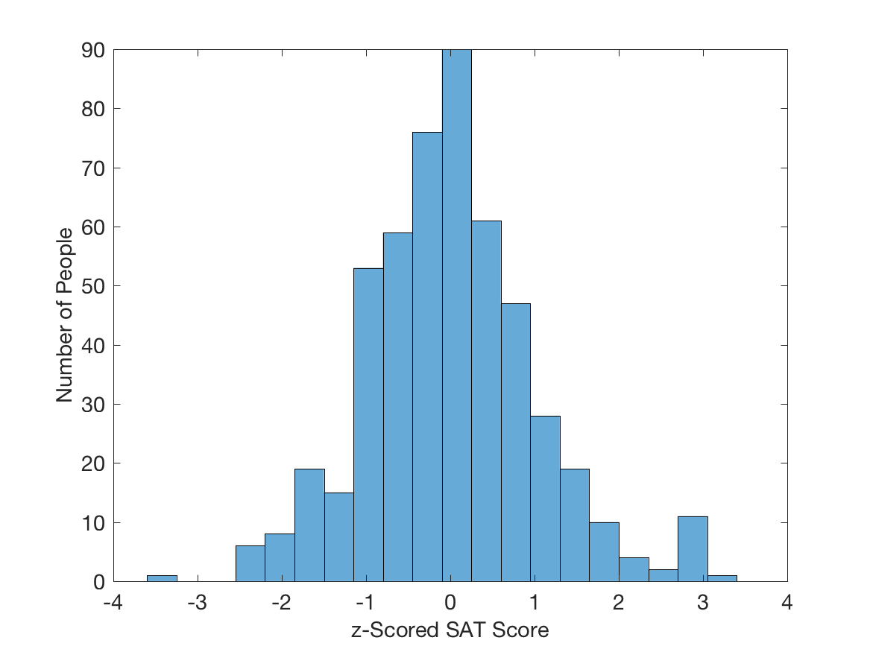
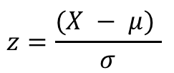
Outlier Detection via z-Scoring
ZM
Outliers
$$z=\frac{(X − μ) }{σ}$$
https://en.wikipedia.org/wiki/Normal_distribution
Tells how many SDs each data value is from the mean.

Slide 11
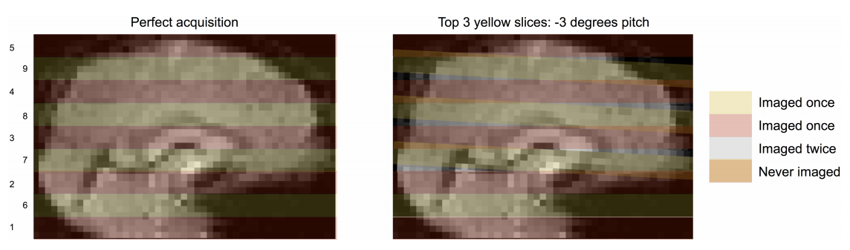
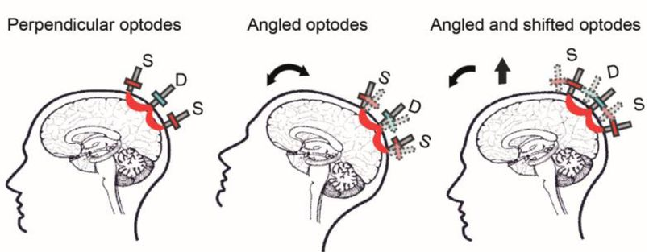
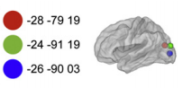
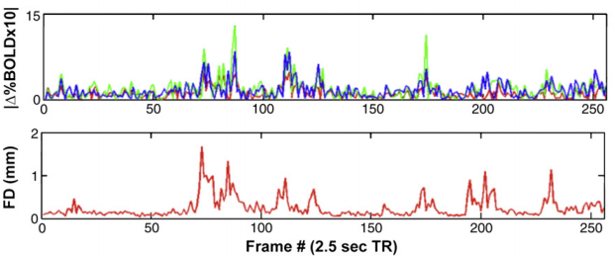
1a. Outliers in neuroimaging
MW
fMRI shift in voxels == signal intensity outliers
DOT fiber decoupling == signal intensity outliers
Power et al. (2017) PLOS one
Power et al. (2012) NeuroImage
Sherefati et al. (2020) bioRxiv

Slide 12
1b. Population vs Sample Statistics
MW
A population contains all members of a specified group (e.g. all people in the US)
E.g. 2020 is the year of the US census
A sample data set contains a subset of the population (e.g. people self quarantined)
It is not economically or practically feasible for all research to measure the population
15.6 billion to administer the 2020 census
Research utilizes random sampling from the population to estimate effects
e.g. online surveys poll individuals currently self-quarantined to measure anxiety
Use probability to make statements about the population

Slide 13
Sampling Example from Seeing Theory
ZM
Anything that you calculate about the population from a sample will be more reliable/repeatable if your sample is big (surprise!).
…More quantitatively, if you draw a bunch of samples, the thing you are calculating from them is a random number and has its own distribution (which depends on sample size for the reason above).
Example at: https://seeing-theory.brown.edu/probability-distributions/index.html#section3

Slide 14
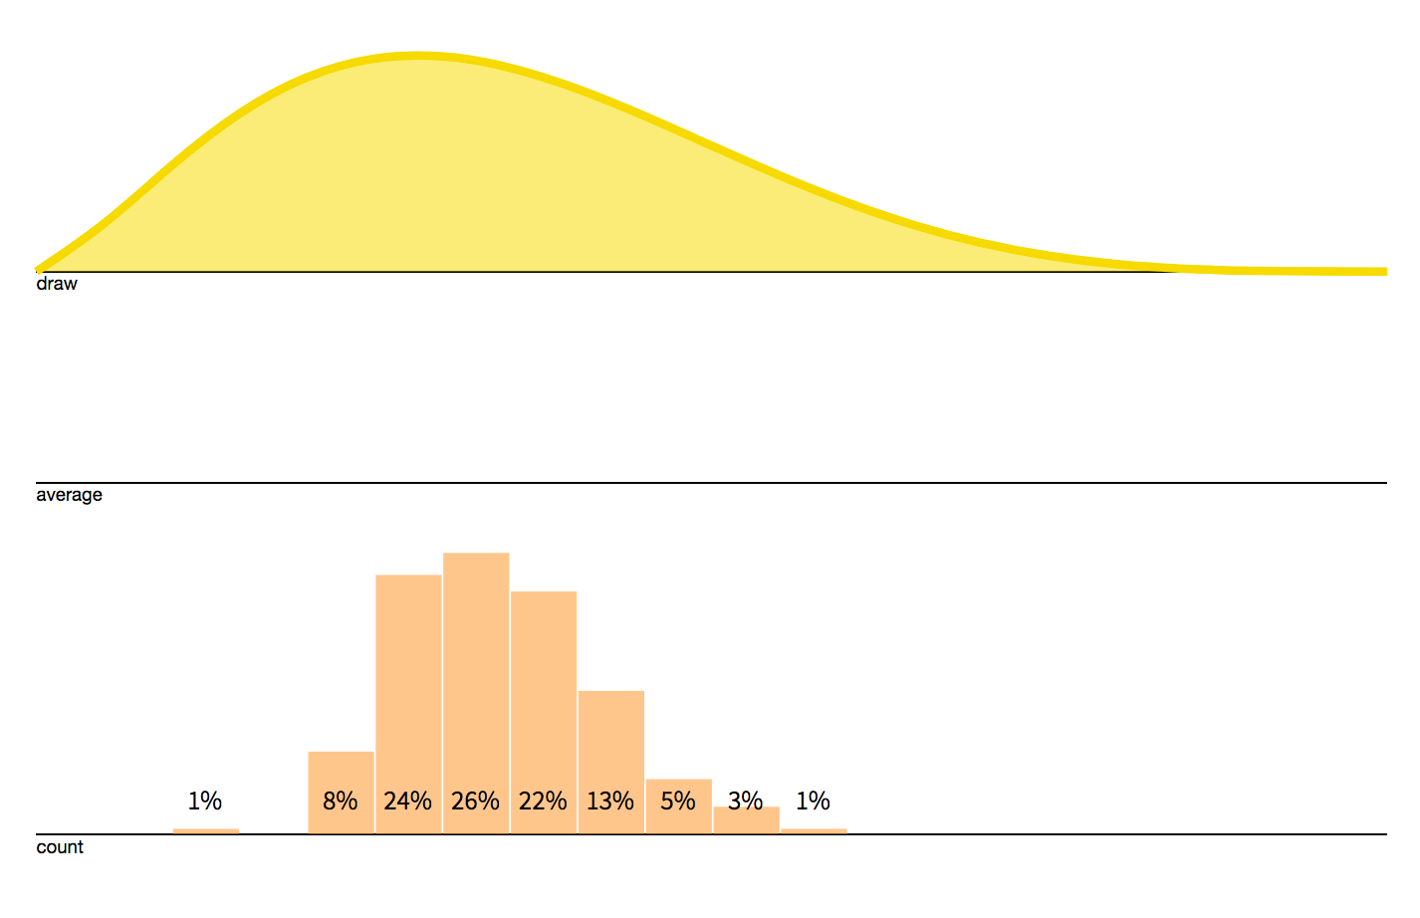
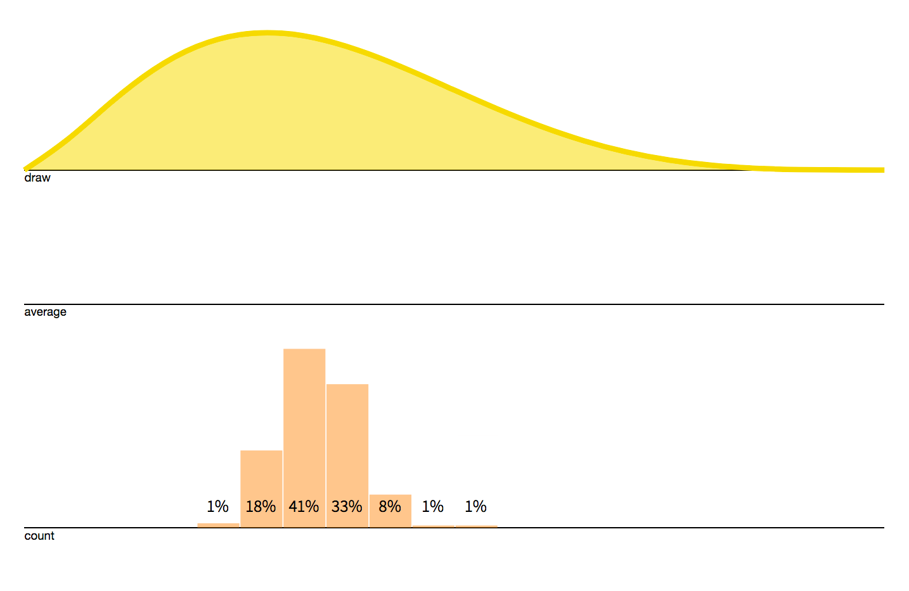
Sampling Example from Seeing Theory
ZM
Population Distribution of Values
Beta Dist. (a = 2.56, b = 5)
Shows variability in values across population.
Values of Sample Mean (from 200 samples/’studies”) when there are 5 values per sample/study.
Shows variability in the mean that you calculate from a sample.
Values of Sample Mean (from 200 samples/’studies”) when there are 15 values per sample/study.
https://seeing-theory.brown.edu/probability-distributions/index.html#section3

Slide 15
Sampling Example from Seeing Theory
ZM
Population Distribution of Values
Beta Dist. (a = 2.56, b = 5)
Shows variability in values across population.
Central Limit Theorem: When the number of values per sample is large and the values are independently measured, the sample mean has a Gaussian distribution with mean = population mean and variance = population variance/sample size. This is true regardless of population distribution shape!
https://seeing-theory.brown.edu/probability-distributions/index.html#section3

Slide 16

1b. Population vs Sample Statistics
MW
Caveats to sampling statistics
It is an estimate of the population
Samples of small size may falsely find a true effect where there is none in the population
There is a positive publication bias in the literature
Reproducibility crisis in science

Slide 17
2.0 Hypothesis testing

Slide 18
Hypothesis Testing
MW
What is it?
Establishing a likelihood or confidence that a finding is true
The likelihood that your sample results will generalize to the population (i.e. replication)
Null hypothesis
Always the default (H0 – H ‘not’)
H0: there are no observable differences
Alternative Hypothesis
H1: (your hypothesis) that there are differences
Can be a directional hypothesis (i.e. a negative or positive effect)

Slide 19
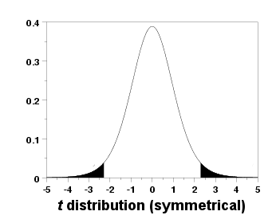
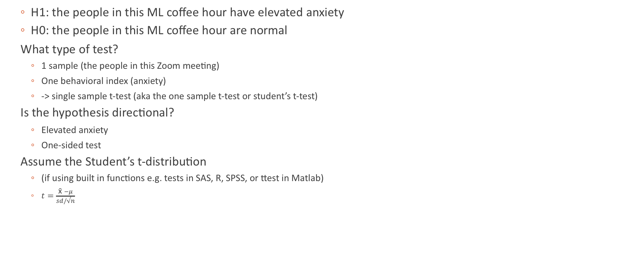
Hypothesis testing example
MW
H1: the people in this ML coffee hour have elevated anxiety
H0: the people in this ML coffee hour are normal
What type of test?
1 sample (the people in this Zoom meeting)
One behavioral index (anxiety)
-> single sample t-test (aka the one sample t-test or student’s t-test)
Is the hypothesis directional?
Elevated anxiety
One-sided test
Assume the Student’s t-distribution
(if using built in functions e.g. tests in SAS, R, SPSS, or ttest in Matlab)
$t=\frac{\text{x}\text{̄ }−μ}{sd/√n}$

Slide 20
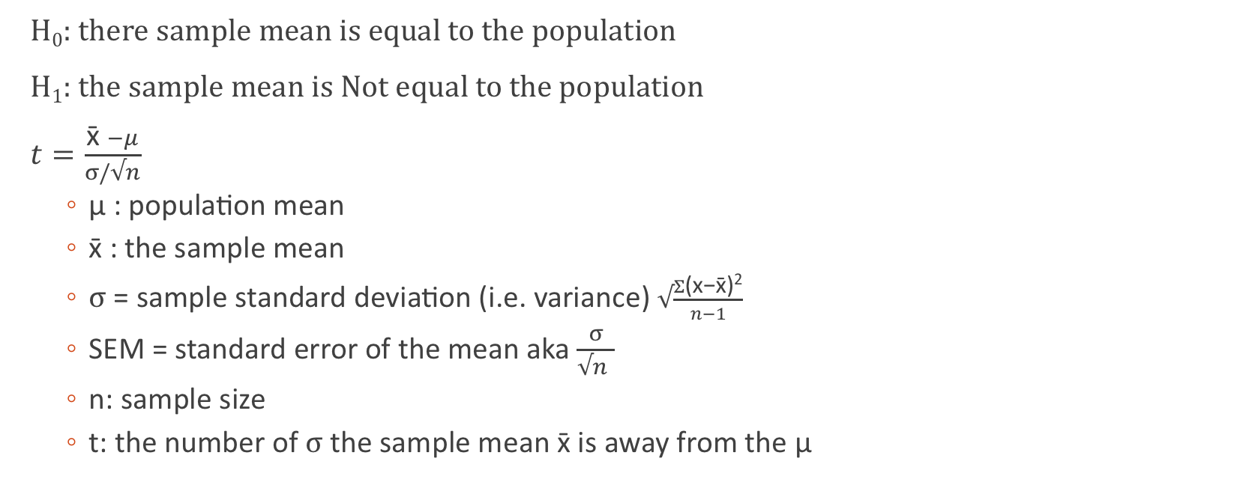
One sample t-test
MW
H₀: there sample mean is equal to the population
H₁: the sample mean is Not equal to the population
$t=\frac{\text{x}\text{̄ }−μ}{σ/√n}$
μ : population mean
x̄ : the sample mean
$σ$ = sample standard deviation (i.e. variance) $√\frac{Σ\text{(}\text{x}\text{−}\text{x}\text{̄)2}}{n−1}$
SEM = standard error of the mean aka $\frac{σ}{√n }$
n: sample size
t: the number of $σ$the sample mean $\text{x}\text{̄}$ is away from the μ
μ
H₀
H₁
H₁
(two tailed)
Single Sample t-test Example in Matlab

Slide 21
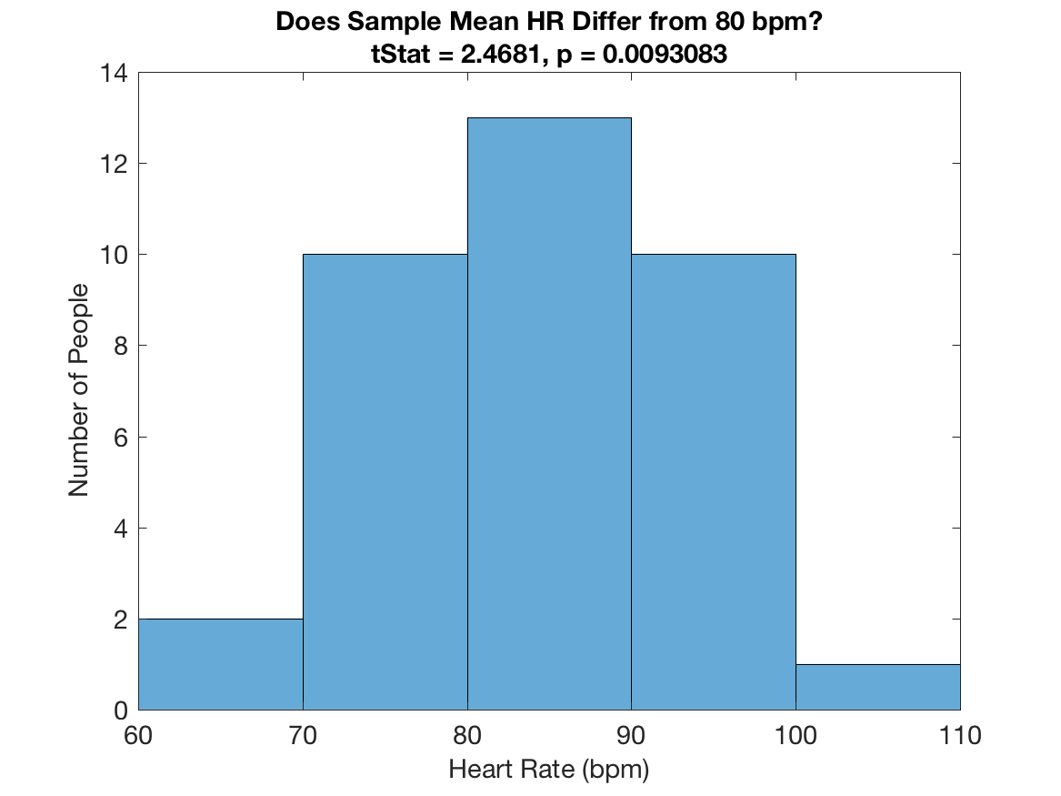
One-Sample t Test Example: Average Heart Rate of 36 People
ZM

Slide 22
Assumptions and Parametric vs. Non-Parametric Tests
ZM
Common parametric statistical tests assume that samples come from distributions with well-known shapes given by a few parameters (e.g., Gaussian, which is characterized by mean and variance).
Usually rely on estimating those parameters.
t-tests assume that population is Gaussian.
Non-parametric tests require fewer assumptions about distribution shape.

Slide 23
How do you know whether your data are normally distributed?
ZM
One way = 1-sample Kolmogorov-Smirnov test.
Null hypothesis = My sample came from a Gaussian distribution.
1-sample KS test works by comparing cumulative distribution function (distribution shape) of your sample to the standard Gaussian.

Slide 24
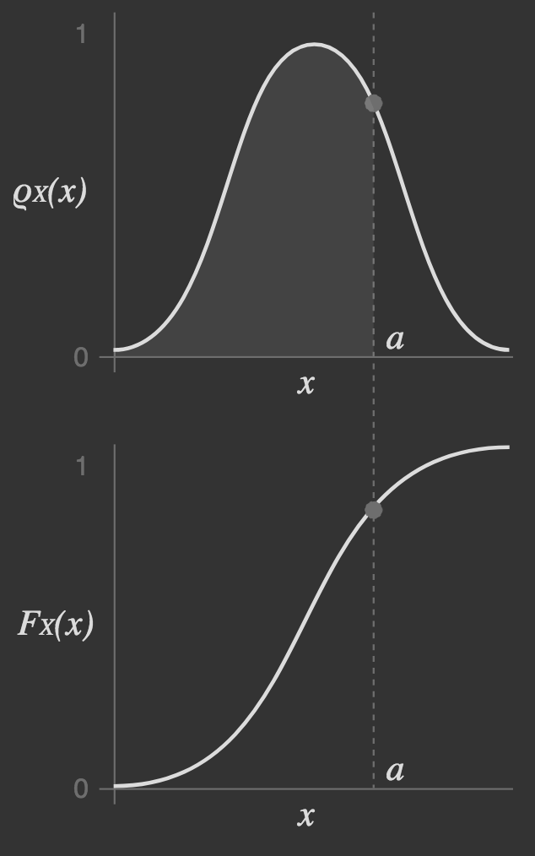
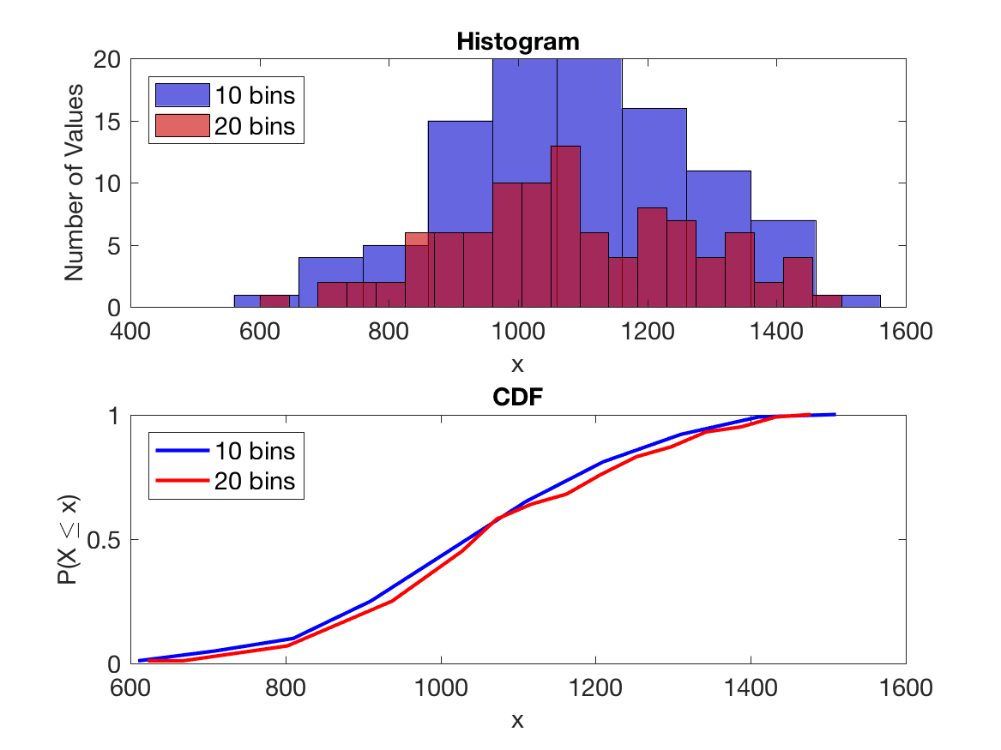
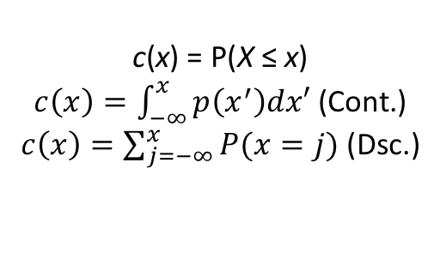
Cumulative Distribution Function (CDF): Alternative way to represent shape
ZM
Example: CDF less sensitive to binning choice and reflects distribution shape when small bins are used.
p(x) = P(X = x)
PDF
c(x) = P(X ≤ x)
$c\left(x\right)=\int_{−∞}^{x}{p\left(x^{′}\right)dx′}$ (Cont.)
$c\left(x\right)=\sum_{j=−∞}^{x}{P(x=j)}$ (Dsc.)
CDF
https://www.internalpointers.com/post/cumulative-distribution-function-cdf

Slide 25
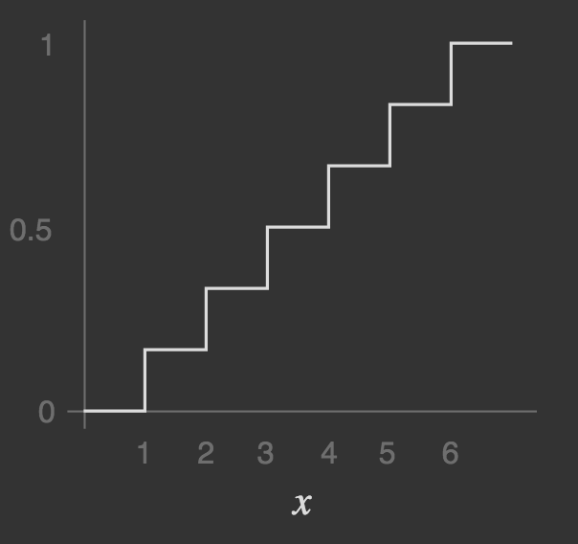
Cumulative Distribution Function (CDF): Alternative way to represent shape
ZM
Discrete CDFs are always stairstep functions.
Here, X = number rolled on a fair 6-sided die.
P(X ≤ x)
https://www.internalpointers.com/post/cumulative-distribution-function-cdf

Slide 26
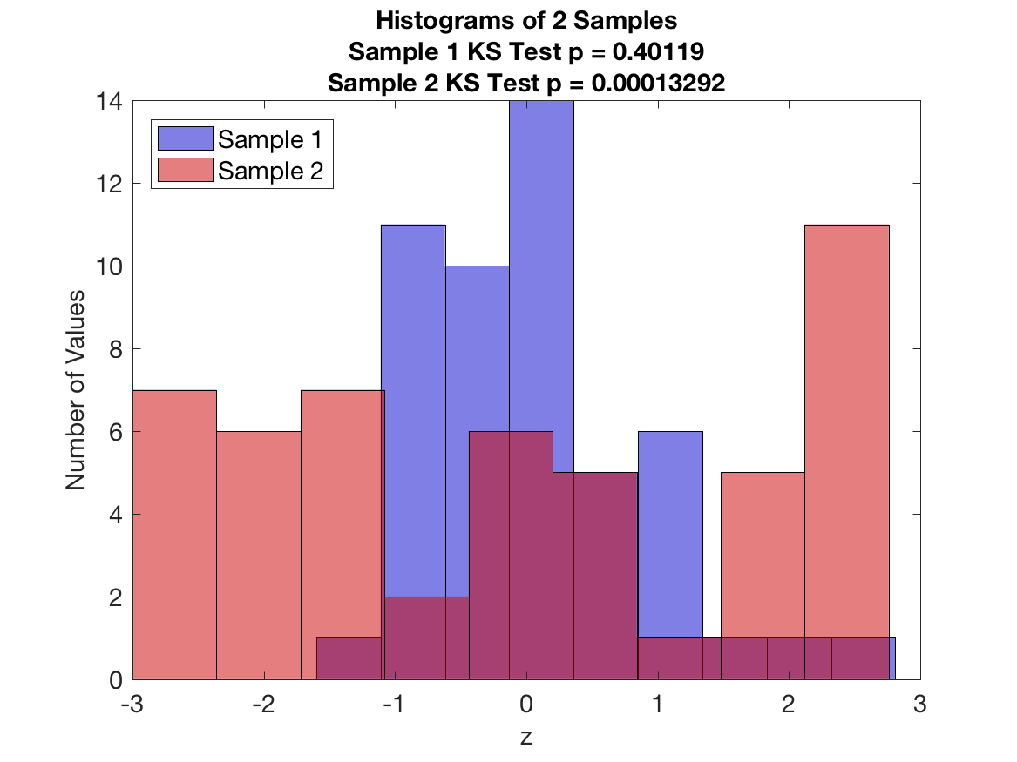
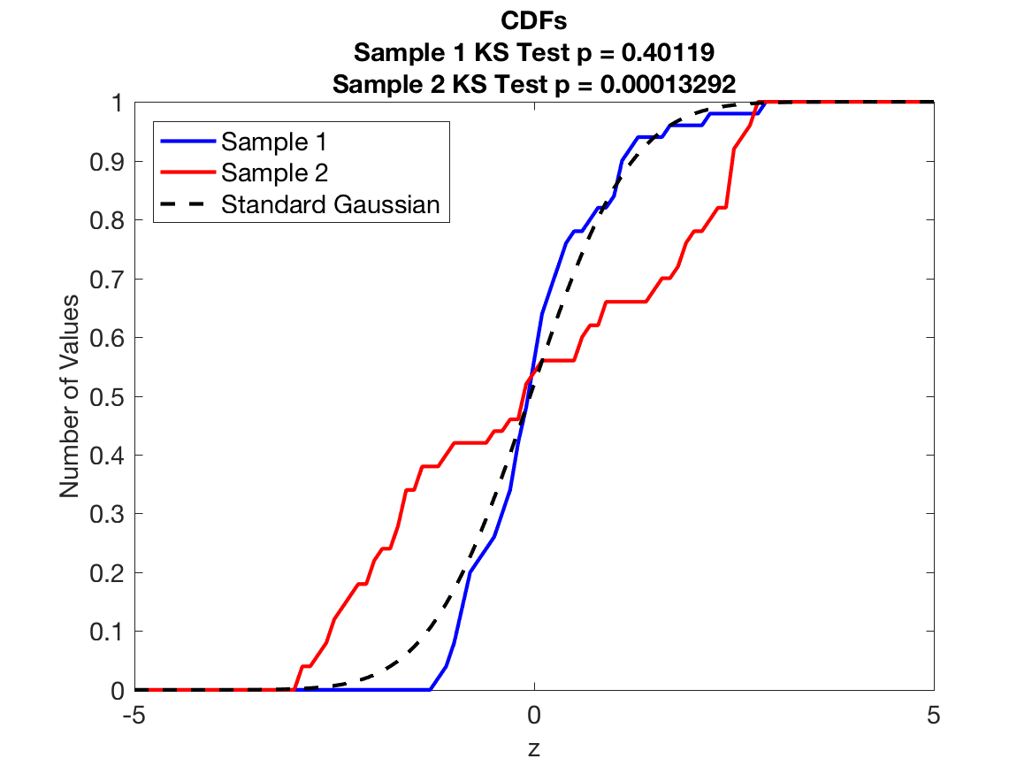
1-Sample Kolmogorov-Smirnov Test Example
ZM

Slide 27
Other types of hypothesis testing
ZM
Differences in sample distribution means (parametric)
Student’s t-test (one sample)
Independent samples t-test (two samples – assumes they do not significantly differ in variance)
Paired samples t-test (one group, but 2 conditions or timepoints)
Welch’s test (two independent groups - assumes unequal variance)
Analysis of Variance (ANOVA) – more on this in two weeks!
Differences in sample distributions (non parametric)
Mann-Whitney U (single or two independent groups)
Wilcoxon Signed-Rank (Rank sum test) (single or two independent groups)
Kruskal-Wallis H (two or more groups - aka ANOVA on ranks – more on this next time)
Test for uneven variance in Matlab (vartest2)
Welch’s t example

Slide 28
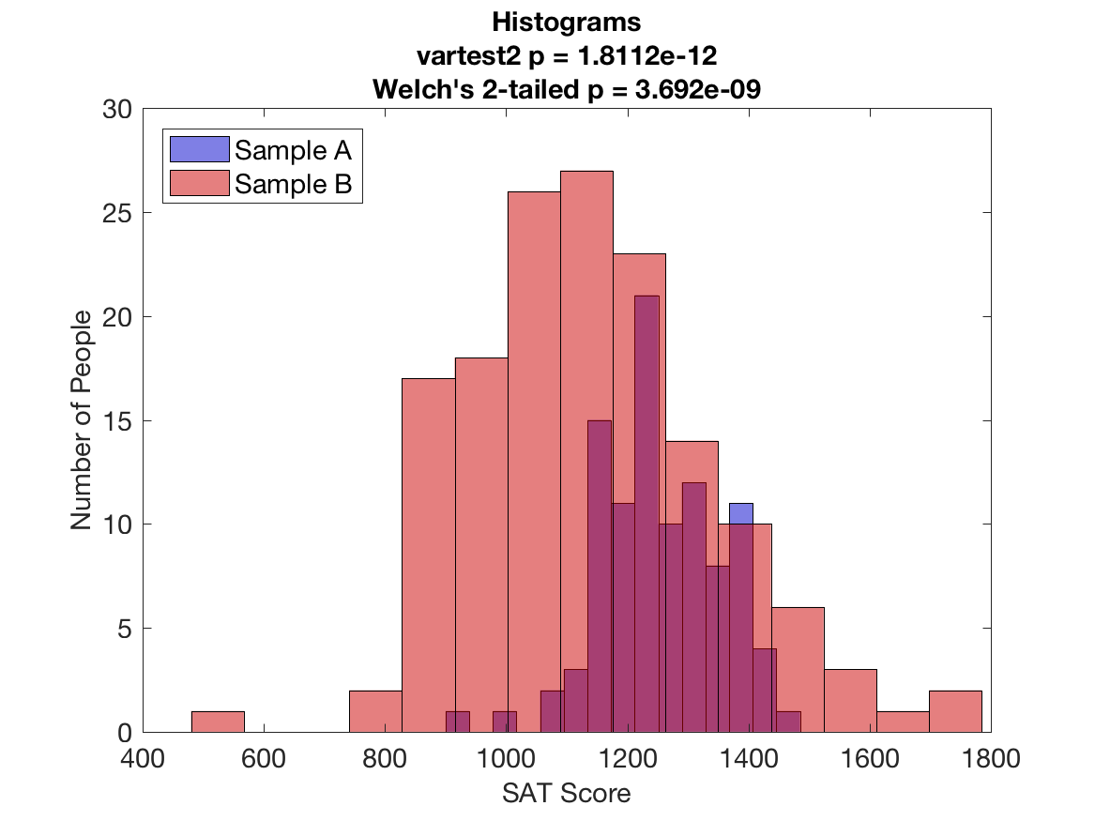
2-Sample t-Test with Unequal Sample Variances (vartest2, Welch’s t)
ZM

Slide 29
Other types of hypothesis testing contd.
ZM
Compare sample distribution shapes
Shapiro – Wilk
Test for normality – significance indicates that nonparametric statistics should be used
(works well with small <50 or large i.e. 2000 sample size)
Kolmogorov-Smirnov
works best with large samples
MATLAB kstest assumes normal distribution; kstest2 is nonparametric comparison of distributions between two groups
Correlation (assumes two variables)
Pearson (parametric)
Spearman (non parametric)
Run kstest2 example in Matlab
(visualize CDFs for two different groups)

Slide 30
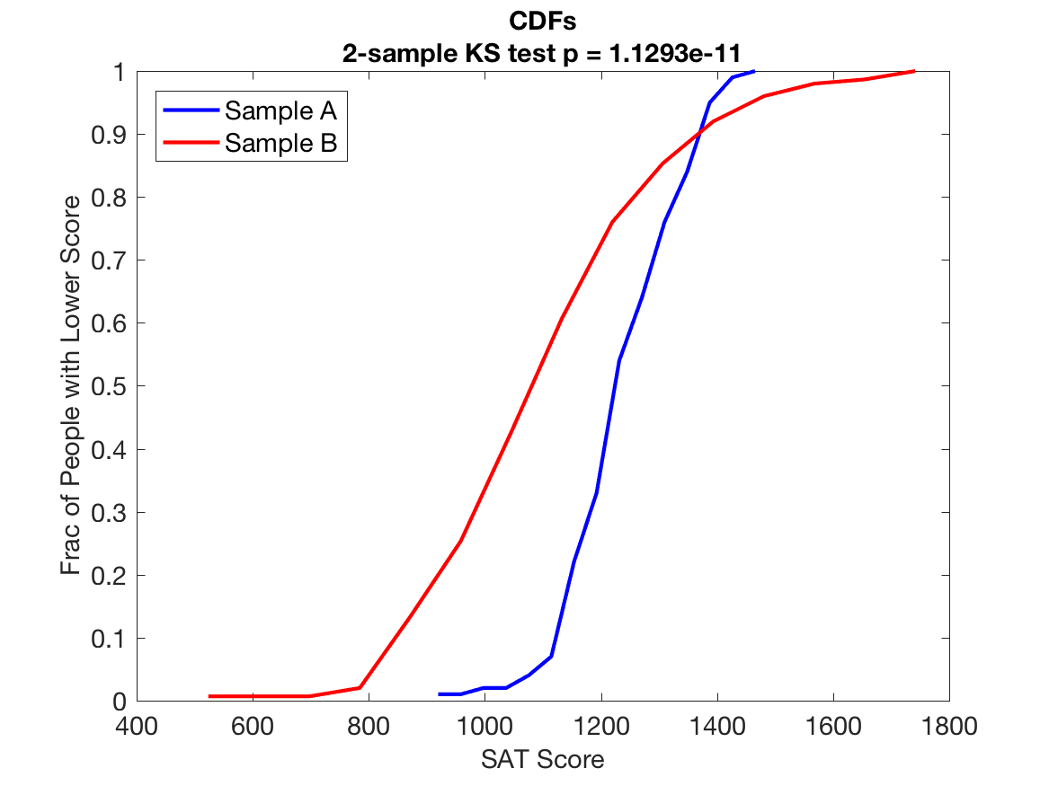
2-Sample KS Test on Same Dataset
ZM

Slide 31
3.0 Interpreting hypothesis tests

Slide 32
Interpreting Hypothesis tests
MW
You now have a
test statistic value
p value
What now?
p value indicates the likelihood that the result wasn’t due to chance
But is it meaningful?

Slide 33

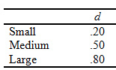
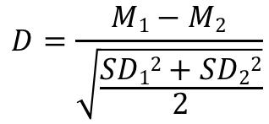
Interpreting Hypothesis tests
MW
11,000 children
Statistically significant vs Clinically/Biologically meaningful
Large sample sizes impact test statistics
For example: Functional connectivity is compared between two groups of 5,000 children
Fc in the prefrontal cortex significantly differed between group p<0.0001 M₁=0.015 M₂=0.016 SD=0.01
Effect Size
Magnitude of the difference
Raw effect size: Difference in means
Standardized effect size: Cohen’s d
Is a fc difference in means of 0.001 biologically meaningful?
Cohen’s d =0.1
Two sample t-test
$$D=\frac{M1−M2}{\sqrt{\frac{SD12+SD22}{2}}}$$

Slide 34
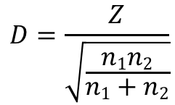
Interpreting Hypothesis tests
MW
Statistically significant vs Clinically/Biologically meaningful
Large sample sizes impact test statistics
For example: Functional connectivity is compared between two groups of 5,000 children
Fc in the prefrontal cortex significantly differed between group p<0.0001 M₁=0.015 M₂=0.016 SD=0.01
Effect Size
Magnitude of the difference
Raw effect size: Difference in means
Standardized effect size: Cohen’s d
Is a fc difference in means of 0.001 biologically meaningful?
Two sample t-test
Two sample KS
$$D=\frac{M1−M2}{\sqrt{\frac{SD12+SD22}{2}}}$$
$$D=\frac{Z}{\sqrt{\frac{n1n2}{n1+n2}}}$$
MATLAB example with Cohen’s d for t-test and KS test

Slide 35
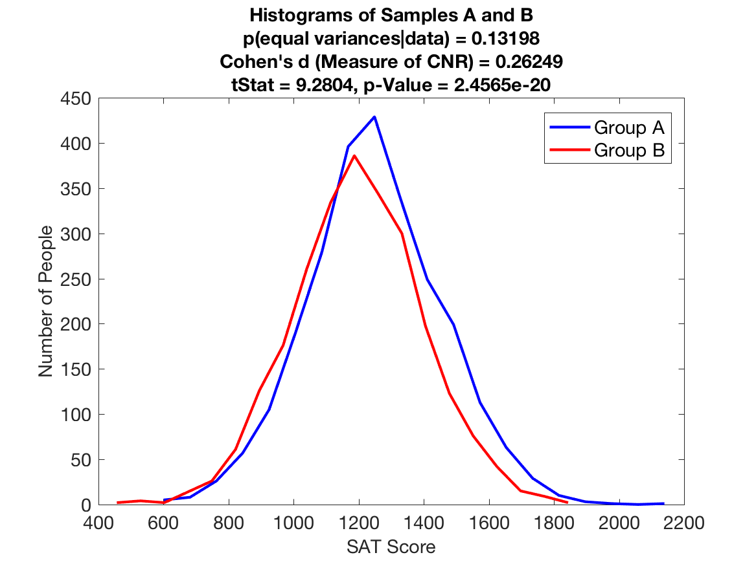
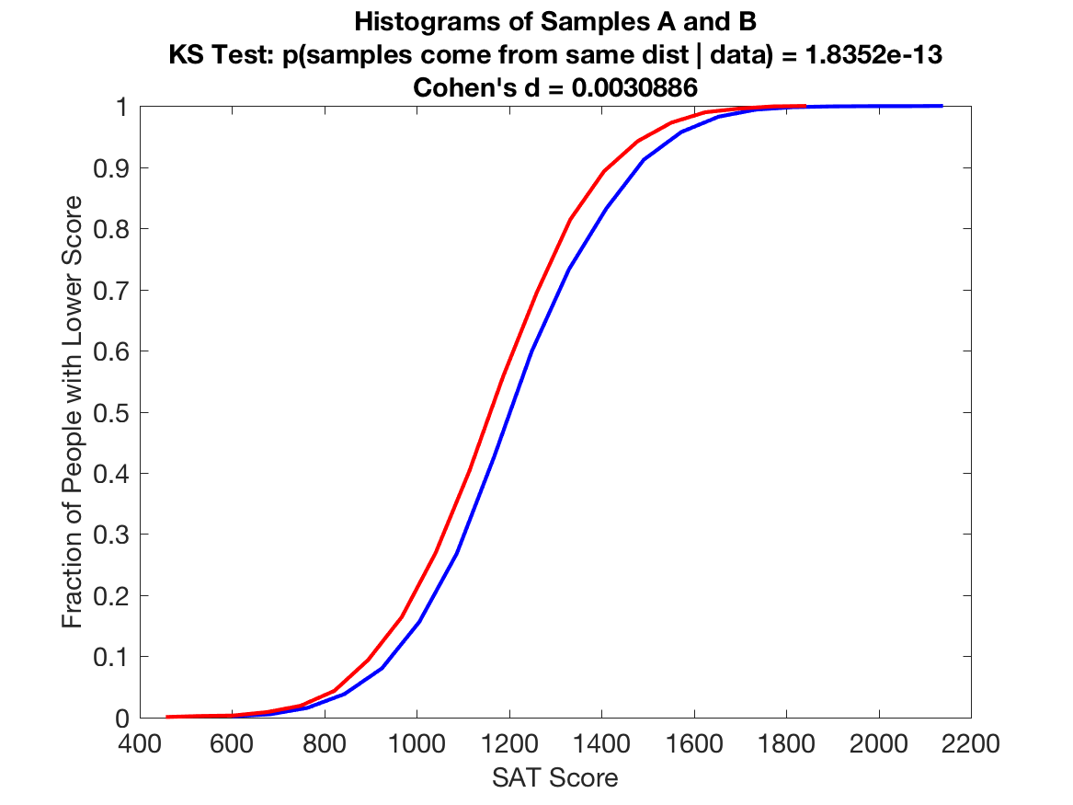
Effect Size ≠ Statistical Significance
MW

Slide 36
Interpreting Hypothesis tests
Statistical tests use assumed null distributions.
What if we aren’t confident that the assumed distribution is appropriate?
Permutation testing can be used to create a null distribution.
Shuffle the ID labels for your sample 10,000 times to create a null distribution.
Use an appropriate test to compare your measured sample to the permuted null.
Logic: If your two samples come from the same distribution/population, then it should not change your results significantly if you mix up the labels telling which group each value belongs to.

Slide 37
Permutation Test Example: Difference in Means (Conceptual Illustration)
 |  |  |  |  |  |  | Mean1 – mean2 (test statistic)
Values | 0.1 | 0.15 | 0.2 | -0.1 | 0.5 | 0.3
True sample membership | 1 | 1 | 1 | 2 | 2 | 2 | -0.23 (observed)
Permuted labels | 1 | 2 | 2 | 1 | 2 | 1 | -0.183
Permuted labels | 2 | 2 | 1 | 1 | 2 | 1 | 0.083
Observed
Value
Null Dist
…

Slide 38
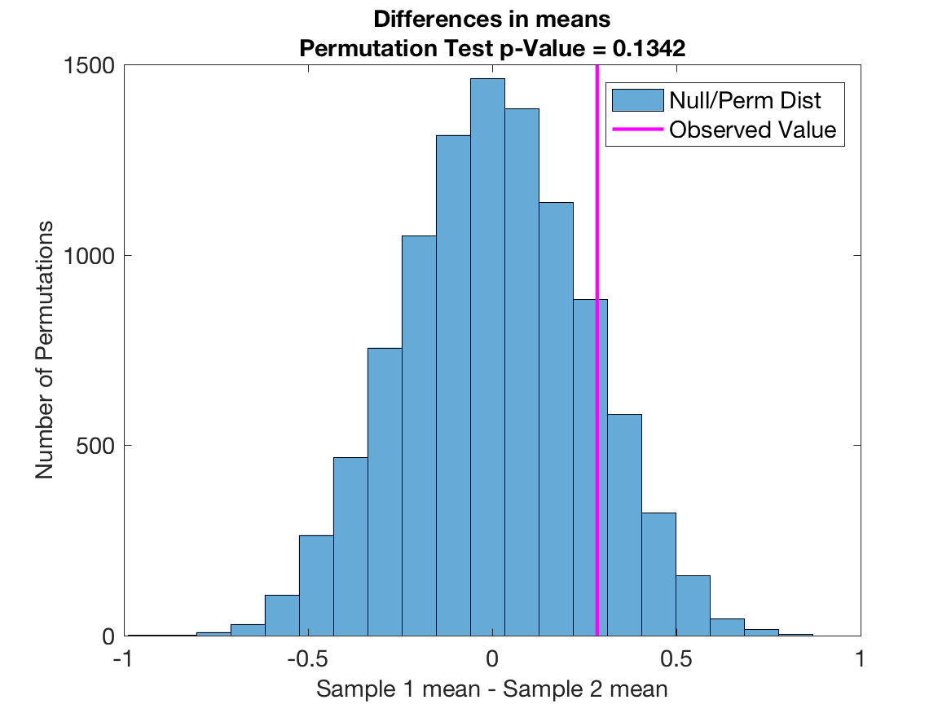
MATLAB Permutation Test Example: Difference in Means

Slide 39
4.0 Type I and II errors

Slide 40
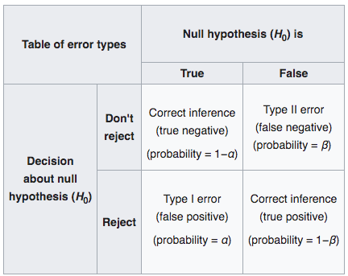
Type I and Type II errors
ZM
Type 1: the incorrect rejection of a true null hypothesis
false positive
Alpha level
Type 2: The incorrect failure to reject the null hypothesis
false negative
Beta
wikipedia

Slide 41
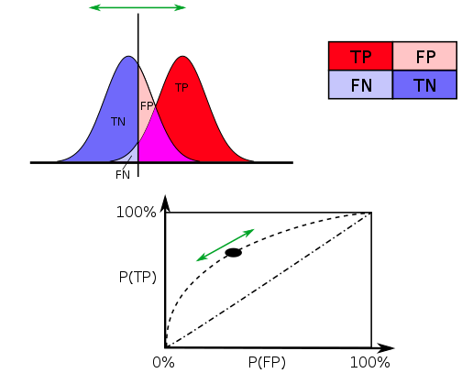
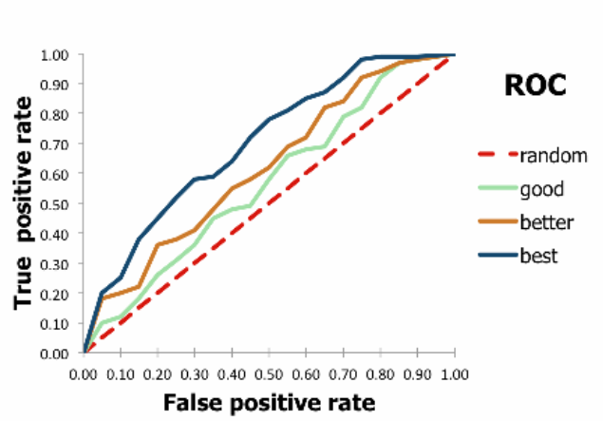
Type I and Type II errors
ZM
Decision Threshold
Confusion Matrix
Receiver-Operator Characteristic (ROC) Curve
PDF of TS if H0 is true
PDF of TS if H1 is true
Test Statistic (TS)
∝
1-β
wikipedia
Notes:
False positive and false negative rate are inherently linked
Generally, decreasing one will cause and increase in the other
ROC curves can be used to track how well different statistical methods (including ML methods) perform

Slide 42
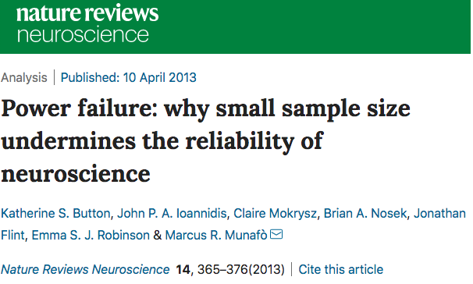
Statistical power
MW
Power is the probability of correctly rejecting the null hypothesis
(i.e. avoiding a type II error)
The probability of not making a type II error is 1-β
Standard research practice sets beta at 0.8-0.9 (i.e. 10-20% chance of a false negative)
Typically used in grant applications to justify choice of sample size
given measured effect size (prelim data or published effect size in literature)
Alpha 0.05
Power of .8 to detect an effect
Matlab: sampsizepwr
G*Power Software
http://www.psychologie.hhu.de/arbeitsgruppen/allgemeine-psychologie-und-arbeitspsychologie/gpower.html

Slide 43
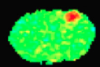
What if you run more than one test
MW
Running multiple tests on a single dataset or under a single hypothesis is a ‘family’ of tests
Example: Testing the effect of forepaw stimulation on all pixels in the field of view
Running more than one hypothesis test increases the odds of falsely rejecting the null
Example: Alpha of 0.05 controls the false positive rate at 5% for each pixel
For 1000 tests with p<0.05, 50 tests will be false positives
P(making at least 1 false positive based on running m tests) = 1-(1-alpha)^{m}
Approaches to Multiple Comparisons Correction (MCC)
Family Wise Error (FWE) correction
Bonferoni = alpha/n
Holmes Bonferroni = ranked alpha/n
False discovery rate (1995)
Benjamini-Hochberg or Storey
Matlab with mafdr.m and fdr_bh.m
T-values
Shim et al. (2018) NeuroImage
Notes:
1-(1-0.05)^1000 is !00% chance of making a false positive

Slide 44
Multiple Comparisons Correction
Measured p-values
0.01
0.2
0.9
0.014
0.005
0.0023
0.09
0.009
0.01
0.001
0.9
0.89
0.007
0.0004
0.012
0.003
0.056
0.00043
0.01
0.025
Alpha = 0.05 for 20 tests

Slide 45
Bonferroni
Measured p-values | Bonferroni threshold | Significant?
0.01 | 0.0025
0.2 | 0.0025
0.9 | 0.0025
0.014 | 0.0025
0.005 | 0.0025
0.0023 | 0.0025 | 0.0023
0.09 | 0.0025
0.009 | 0.0025
0.01 | 0.0025
0.001 | 0.0025 | 0.001
0.9 | 0.0025
0.89 | 0.0025
0.007 | 0.0025
0.0004 | 0.0025 | 0.0004
0.012 | 0.0025
0.003 | 0.0025
0.056 | 0.0025
0.00043 | 0.0025 | 0.00043
0.01 | 0.0025
0.025 | 0.0025

Slide 46
Holms-Bonferroni
Measured p-values | Rank | Holm-Bonferroni | Significant?
0.0004 | 1 | 0.050 | 0.0004
0.00043 | 2 | 0.025 | 0.00043
0.001 | 3 | 0.017 | 0.001
0.0023 | 4 | 0.013 | 0.0023
0.003 | 5 | 0.010 | 0.003
0.005 | 6 | 0.008 | 0.005
0.007 | 7 | 0.007 | STOP
0.009 | 8 | 0.006
0.01 | 9 | 0.006
0.01 | 10 | 0.005
0.01 | 11 | 0.005
0.012 | 12 | 0.004
0.014 | 13 | 0.004
0.025 | 14 | 0.004
0.056 | 15 | 0.003
0.09 | 16 | 0.003
0.2 | 17 | 0.003
0.89 | 18 | 0.003
0.9 | 19 | 0.003
0.9 | 20 | 0.003

Slide 47
Benjamini-Hochberg FDR
(rank/n tests)*alpha
p-value*n tests/rank
Measured p-values | Rank | FDR p threshold | Significant? | FDR adjusted p
0.0004 | 1 | 0.003 | 0.0004 | 0.008
0.00043 | 2 | 0.005 | 0.00043 | 0.004
0.001 | 3 | 0.008 | 0.001 | 0.007
0.0023 | 4 | 0.010 | 0.0023 | 0.012
0.003 | 5 | 0.013 | 0.003 | 0.012
0.005 | 6 | 0.015 | 0.005 | 0.017
0.007 | 7 | 0.018 | 0.007 | 0.020
0.009 | 8 | 0.020 | 0.009 | 0.023
0.01 | 9 | 0.023 | 0.01 | 0.022
0.01 | 10 | 0.025 | 0.01 | 0.020
0.01 | 11 | 0.028 | 0.01 | 0.018
0.012 | 12 | 0.030 | 0.012 | 0.020
0.014 | 13 | 0.033 | 0.014 | 0.022
0.025 | 14 | 0.035 | 0.025 | 0.036
0.056 | 15 | 0.038 | STOP | 0.075
0.09 | 16 | 0.040 |  | 0.113
0.2 | 17 | 0.043 |  | 0.235
0.89 | 18 | 0.045 |  | 0.989
0.9 | 19 | 0.048 |  | 0.947
0.9 | 20 | 0.050 |  | 0.900

Slide 48
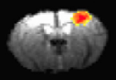
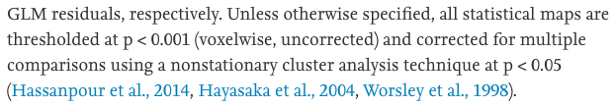
Cluster Correction for control of MCC
MW
Statistical Parametric Mapping (SPM)
FWE p<0.05
Cluster correction
T-values
Shim et al. (2018) NeuroImage
Analysis of Functional Images (AFNI)
Hassanpour et al. (2015) NeuroImage

Slide 49
Summary
MW
Models are based on assumptions and result in error
The goal is to minimize error and explain variance
Outliers result in skew and higher error variance
Assess and clean your data prior to hypothesis testing
Hypothesis testing makes statements about the likelihood that findings are true in the population when measured in a sample
Impacted by
Sample size
Effect size
Variance and outliers
Number of statistical tests

Slide 50
Next time
MW
Correlation
cross correlation and dot products
multivariate outliers
colinearity
Regression
Multiple linear and logistic
Nuisance variables, covariates, shared variance, and residuals
Effect coding, interactions, and nonlinear terms
ANOVA/ANCOVA and sample/cell size
Interpreting model fit
R²
Unequal variance and sphericity
General Linear Model - applications in neuroimaging

